Slide 1
SOLID STATE
Name of the instructor: U.Nithya M.Sc.,M.Phil.,

Slide 2
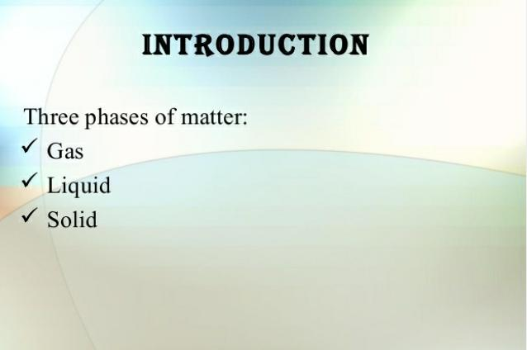

Slide 3
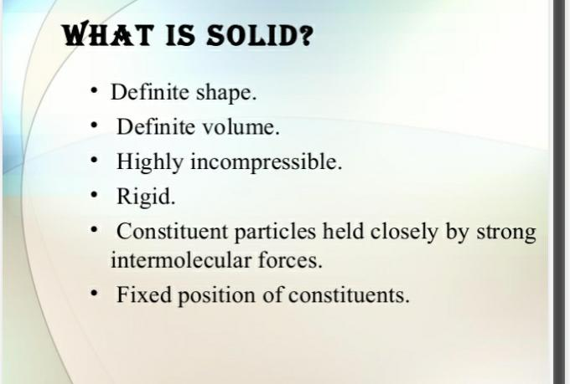

Slide 4
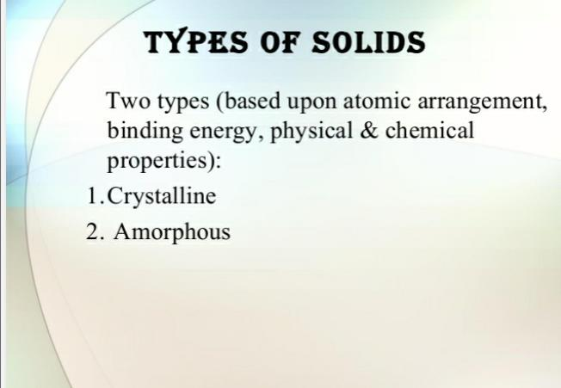

Slide 5
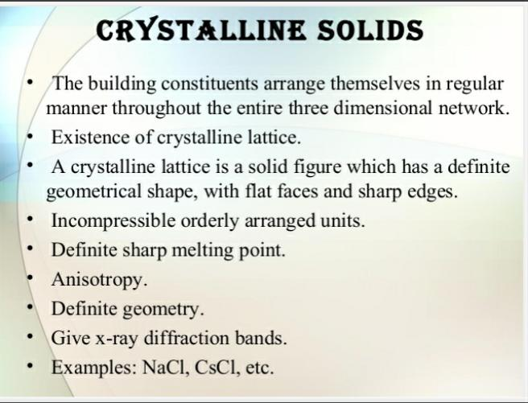

Slide 6
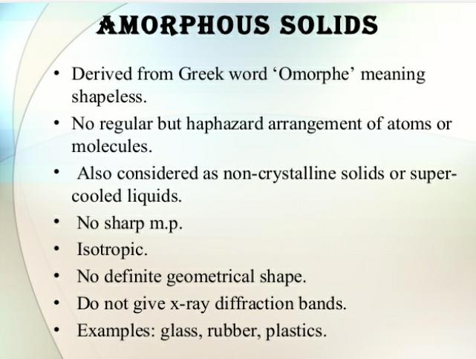

Slide 7
CRYSTAL LATTICE:
Crystal lattice is the depiction of three dimensional arrangements of constituent particles (atoms, molecules, ions) of crystalline solids as points. Or the geometric arrangement of constituent particles of crystalline solids as point in space is called crystal lattice.
Characteristics of crystal lattice:
Each constituent particle is represented by one point in a crystal lattice.
These points are known as lattice point or lattice site.
Lattice points in a crystal lattice are joined together by straight lines.
By joining the lattice points with straight lines the geometry of the crystal lattice is formed.

Slide 8
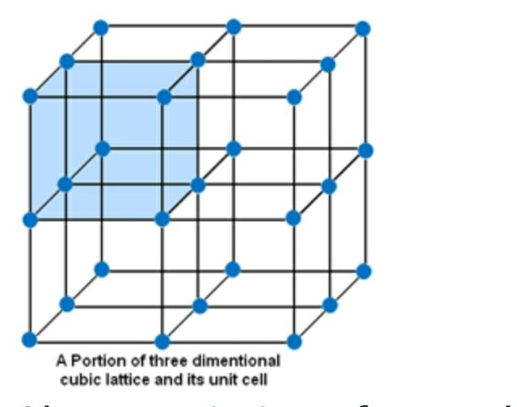

Slide 9
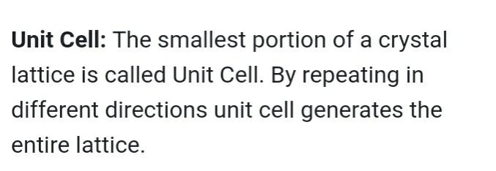

Slide 10
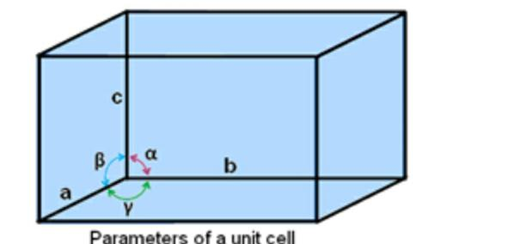

Slide 11
Parameters of a unit cell:
A unit cell is characterized by six parameters. These parameters are three edges (a, b and c) and angles between them (α, β and γ).
Dimensions along the edges of a unit cell is represented by a, b and c.
Edges of unit cell may or may not be mutually perpendicular.
The angle between b and c is represented by α, between a and c by β and between a and b by γ.

Slide 12
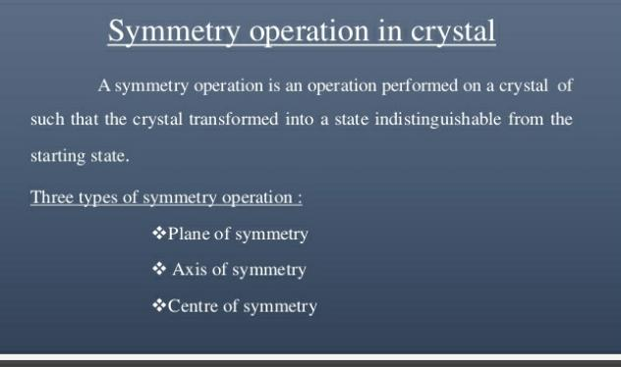

Slide 13
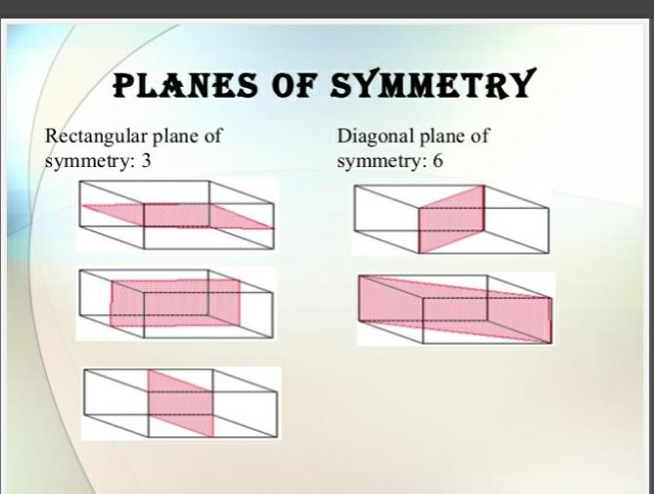

Slide 14
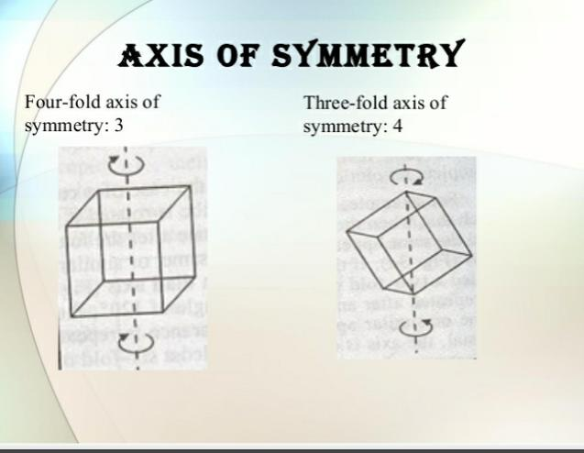

Slide 15
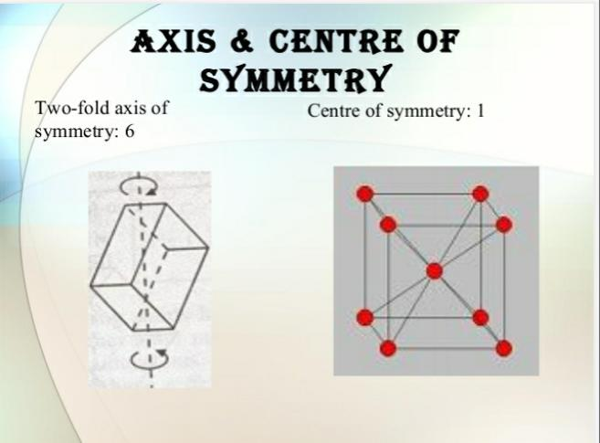

Slide 16
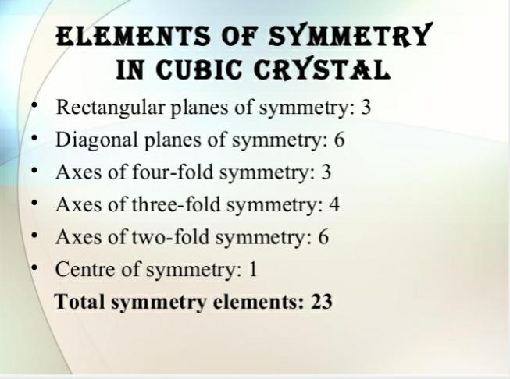

Slide 17
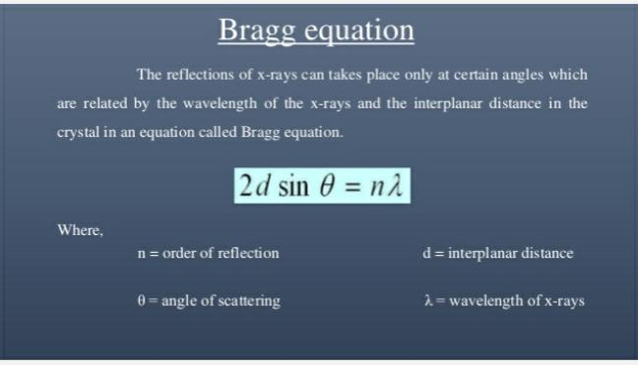

Slide 18
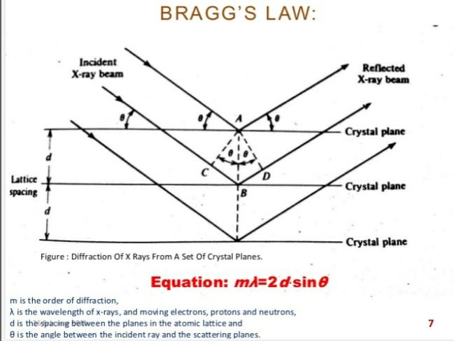

Slide 19
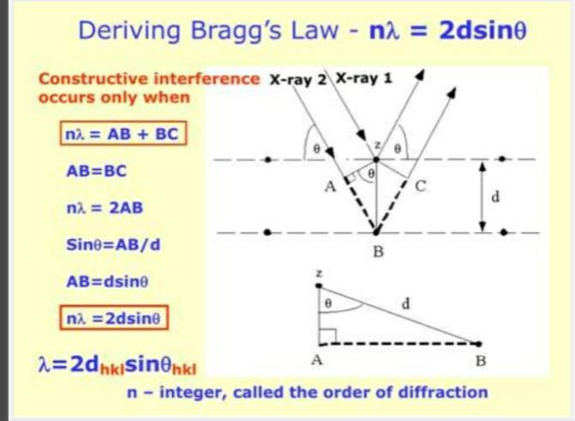

Slide 20
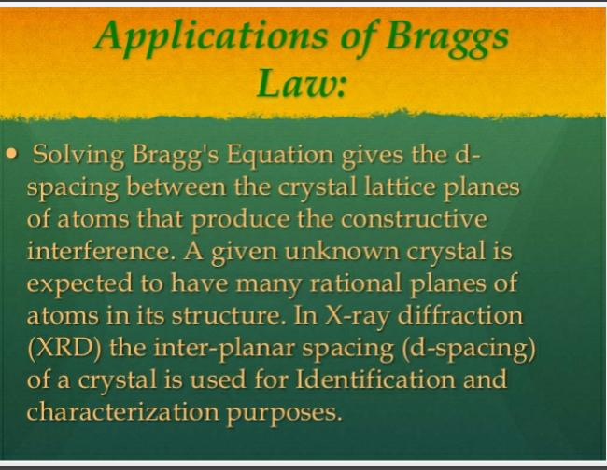

Slide 21
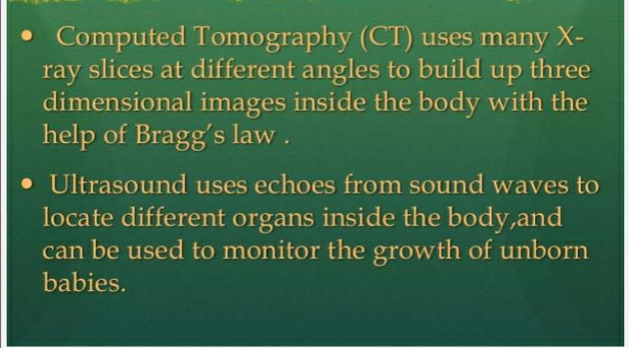

Slide 22
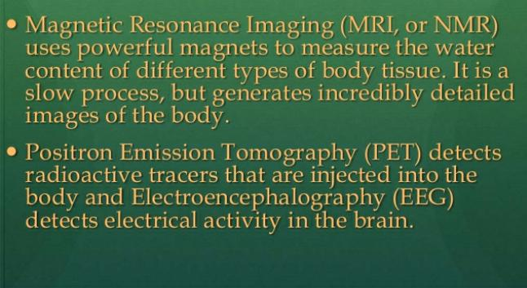

Slide 23
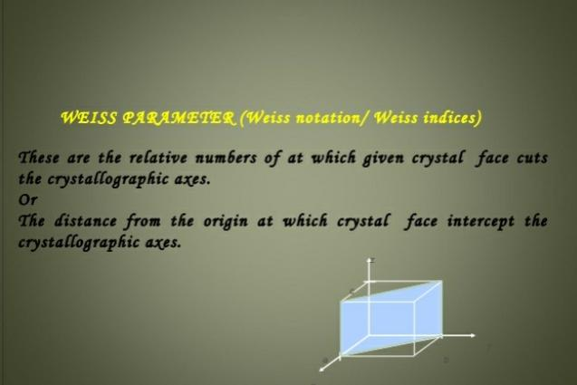

Slide 24
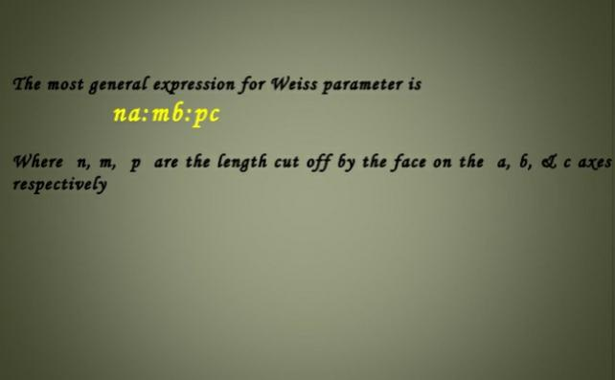

Slide 25
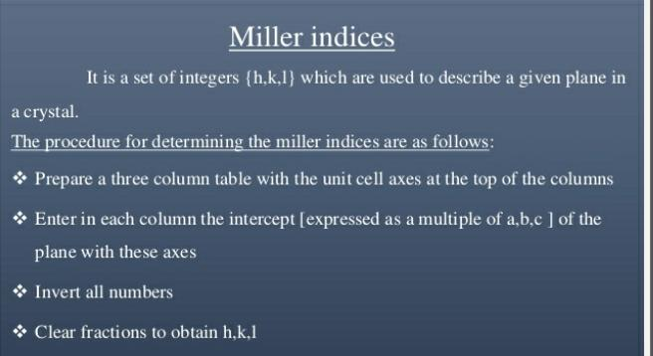

Slide 26
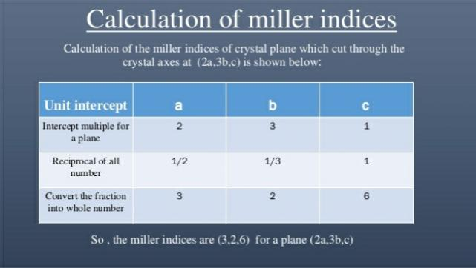

Slide 27
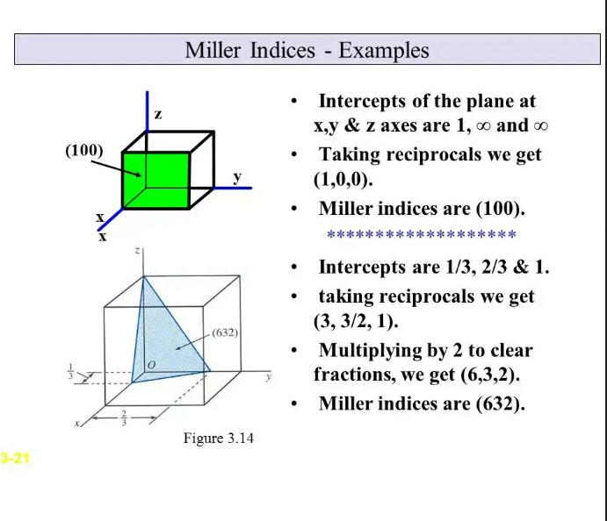

Slide 28
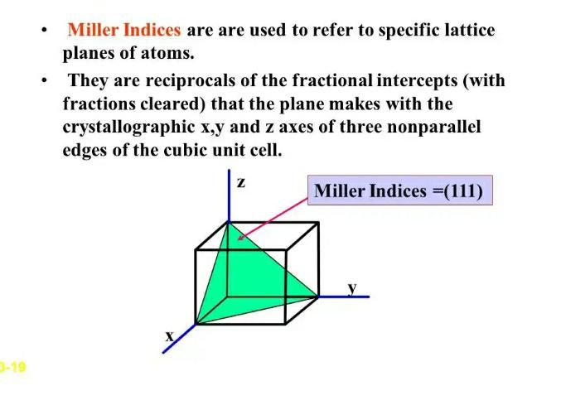

Slide 29
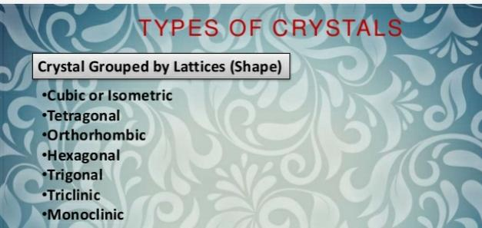

Slide 30
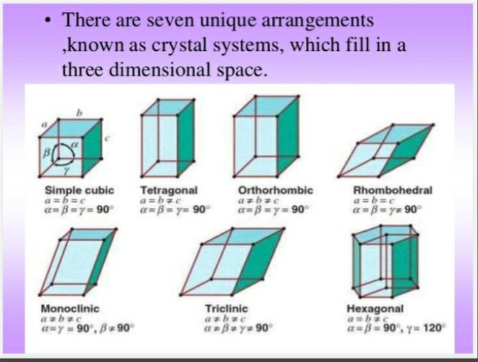

Slide 31
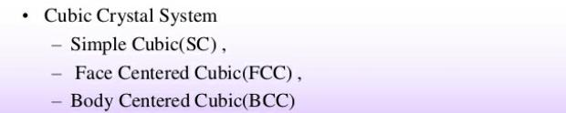

Slide 32
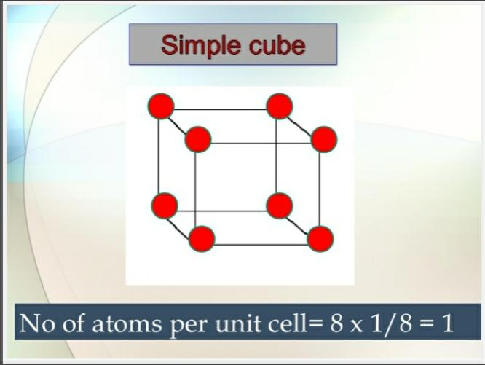

Slide 33
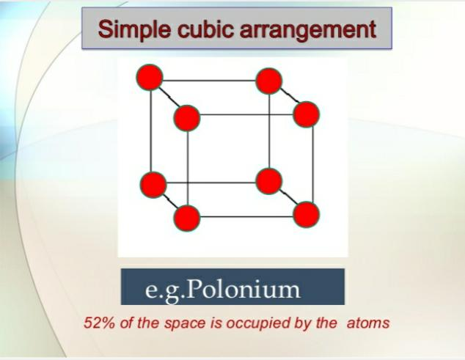

Slide 34
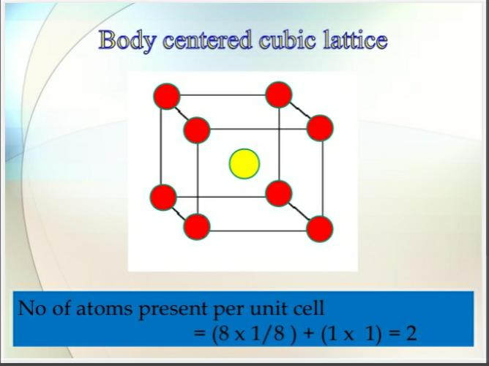

Slide 35
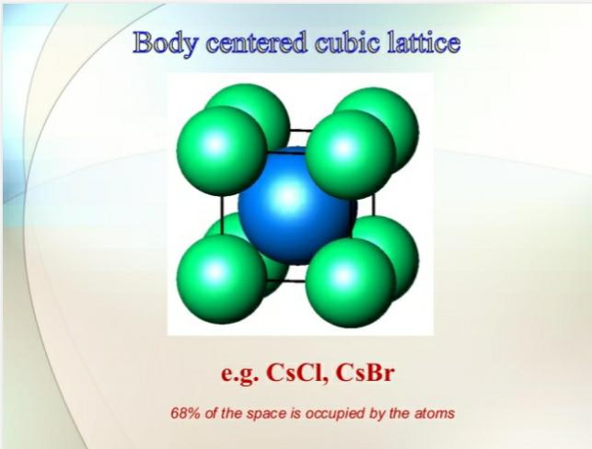

Slide 36
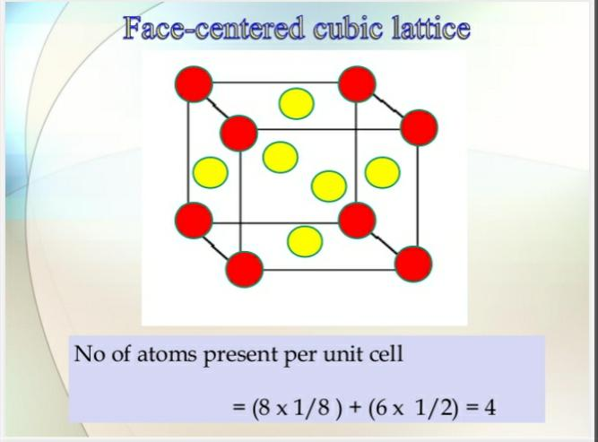

Slide 37
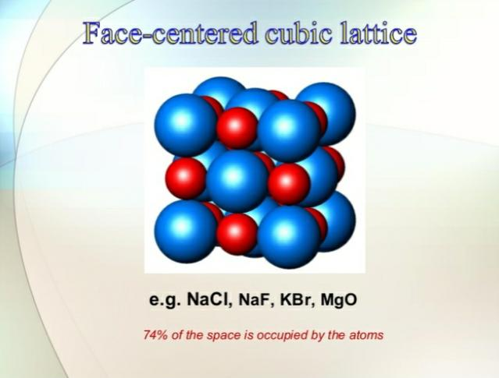

Slide 38
THANK YOU

